Slide 1

Lead Scoring Case Study
Presented By:
Siddharth Vikram Singh

Slide 2

Agenda
The Purpose is to optimize the lead scoring mechanism based on their fit, demographics, behaviors,
buying tendency etc. By implementing explicit & Implicit lead scoring modelling with lead point system.

Slide 3
Problem Statement
An education company named X Education sells online courses to industry professionals. On any given day, many professionals who are interested in the courses land on their website and browse for courses.
The company markets its courses on several websites and search engines like Google. Once these people land on the website, they might browse the courses or fill up a form for the course or watch some videos. When these people fill up a form providing their email address or phone number, they are classified to be a lead. Moreover, the company also gets leads through past referrals. Once these leads are acquired, employees from the sales team start making calls, writing emails, etc. Through this process, some of the leads get converted while most do not. The typical lead conversion rate at X education is around 30%.
Now, although X Education gets a lot of leads, its lead conversion rate is very poor. For example, if, say, they acquire 100 leads in a day, only about 30 of them are converted. To make this process more efficient, the company wishes to identify the most potential leads, also known as ‘Hot Leads’. If they successfully identify this set of leads, the lead conversion rate should go up as the sales team will now be focusing more on communicating with the potential leads rather than making calls to everyone.

Slide 4
Goals of the Case Study
There are quite a few goals for this case study.
Build a logistic regression model to assign a lead score between 0 and 100 to each of the leads which can be used by the company to target potential leads. A higher score would mean that the lead is hot, i.e. is most likely to convert whereas a lower score would mean that the lead is cold and will mostly not get converted. There are some more problems presented by the company which your model should be able to adjust to if the company's requirement changes in the future so you will need to handle these as well.

Slide 5
Approach
Source the data For analysis
Reading & Understanding the data
Data Cleaning
EDA
Feature scaling
Splitting the data into test & train dataset
Prepare the data for modelling
Model building
Model evaluation-specificity & sensitivity or precision recall
Making predictions on the test set

Slide 6
Data Sourcing, Cleaning & Preparation
Read the data from CSV File
Outlier treatment
Data cleaning –Handling Null Values & removing higher Null values data
Removing Redundant columns in the data
Imputing Null Values
Exploratory data analysis-approx. Conversion Rate is 38%
Feature standardization

Slide 7
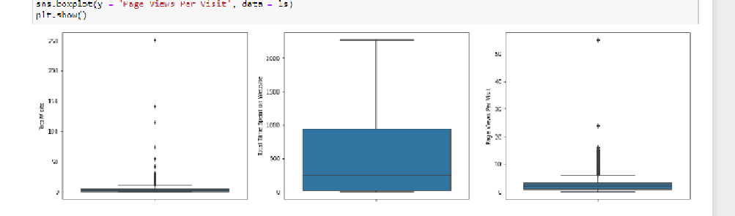
Outliers:
Total Visits, Total Time Spent on Website, Page Views Per Visit have outliers

Slide 8
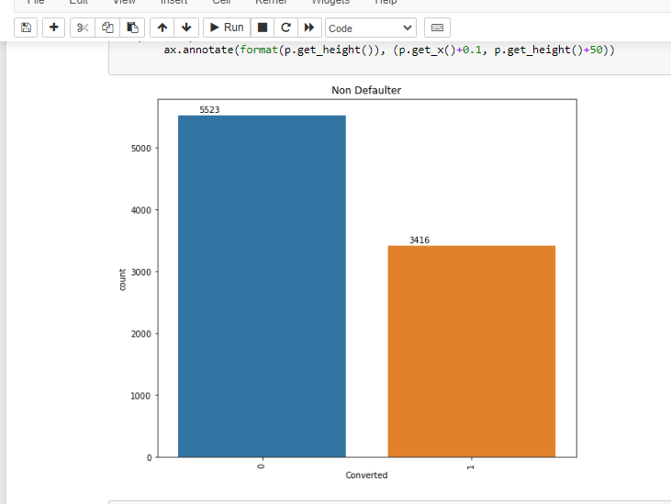
Data Analysis

Slide 9

Data Preparation
Converted Binary variables into 0 & 1
Created dummy variables for categorical variables

Slide 10
Feature Scaling & Splitting Train & Test Sets
Feature Scaling of Numeric Data
Splitting data into Train & Test Set

Slide 11
Model building
Feature Selection using RFE
Determined Optimal Model using Logistic Regression
Calculated accuracy ,sensitivity ,specificity, precision & Recall & evaluate model

Slide 12
Variables Impacting the conversion rate
Total Visits
Total Time Spent on website
Lead Source_Olark chat
Lead Origin_Lead Add Form
Lead Source_Welingak Website
Do Not Email
Lead Source _Referral Sites….etc

Slide 13
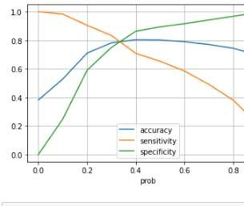
Model Evaluation-Sensitivity & Specificity on Train Data Set
Graph depicts an optimal cutoff of 0.37 bases on Accuracy, Sensitivity, Specificity

Slide 14
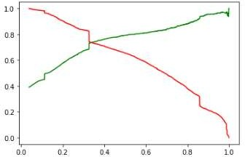
Model Evaluation
Precision & Recall on Train dataset
The graph depicts optimal cut-off of
0.42 based on precision & Recall
Precision =79%
Recall = 65%

Slide 15
Model Evaluation- Sensitivity & Specificity on Test Dataset
Accuracy = 78%
Sensitivity = 80.8%
Specificity =76.5%

Slide 16
Result
Accuracy, sensitivity and specificity values of training and test set are close to training set
Accuracy, sensitivity and specificity values of training set are 79%, 82%, 76% respectively
Accuracy, sensitivity & Specificity values of test are 78%, 81%, 76% respectively
Conversion rate for Train & Test Dataset Is 82.7% & 80.8% respectively
We have done the prediction on the test set using cut off threshold from sensitivity & specificity metrics.

Slide 17
Conclusion
While we have checked both sensitivity-specificity as well as Precision & recall metrics, we have considered the optimal cut off based on sensitivity & specificity for calculating the final prediction
Accuracy, Sensitivity & specificity values of test set are around 78%, 81%, 76% which are approximately closer to Values calculated using Trained Data Set
Lead Score Calculated for the conversion rate final model on Train & Test dataset is 82.7% & 80.8% respectively.
Hence, Overall Model seems to be Good

Slide 18

Summary
There are a lot of leads generated in the initial stage (top) but only a few of them come out as paying customers from the bottom. In the middle stage, you need to nurture the potential leads well (i.e. educating the leads about the product, constantly communicating etc.) in order to get a higher lead conversion. First, sort out the best prospects from the leads you have generated. 'Total Visits' , 'Total Time Spent on Website' , 'Page Views Per Visit' which contribute most towards the probability of a lead getting converted. Then, You must keep a list of leads handy so that you can inform them about new courses, services, job offers and future higher studies. Monitor each lead carefully so that you can tailor the information you send to them. Carefully provide job offerings, information or courses that suits best according to the interest of the leads. A proper plan to chart the needs of each lead will go a long way to capture the leads as prospects. Focus on converted leads. Hold question-answer sessions with leads to extract the right information you need about them. Make further inquiries and appointments with the leads to determine their intention and mentality to join online courses.

